Slide 1
Simple Learning Flashcard Application
Project Link on Github: https://github.com/alextunschi1/SLFA
Module: DLBCSPJWD01 – Project: Java and Web Development
Module Director: Prof. Dr. Holger Klus
Bachelor: Computer Science

Slide 2
SLFA is a versatile MERN stack web application designed to empower individuals who are eager to enhance their learning experience through self-quizzing. With SLFA, you can create, manage, and test your own sets of flashcards, making the learning process more engaging and effective.
Why SLFA?
Learning is a continuous journey, and one of the most effective ways to absorb and retain information is through active engagement. SLFA offers a user-friendly platform to create, update, delete, and test your own flashcard sets, enabling you to take control of your learning process.
Key Features:
1. Flashcard Creation:
SLFA allows you to easily create your own flashcards. Each flashcard set can contain questions and answers, helping you structure your learning materials effectively.
2. Flashcard Management:
Organize your flashcards into sets for different subjects or topics. You have the flexibility to update and delete flashcards as your knowledge grows.
3. Self-Testing:
The heart of SLFA lies in its self-testing feature. Challenge yourself by going through your flashcard sets. You can flip through the cards, attempting to answer the questions, and then reveal the correct answers to reinforce your memory.

Slide 3
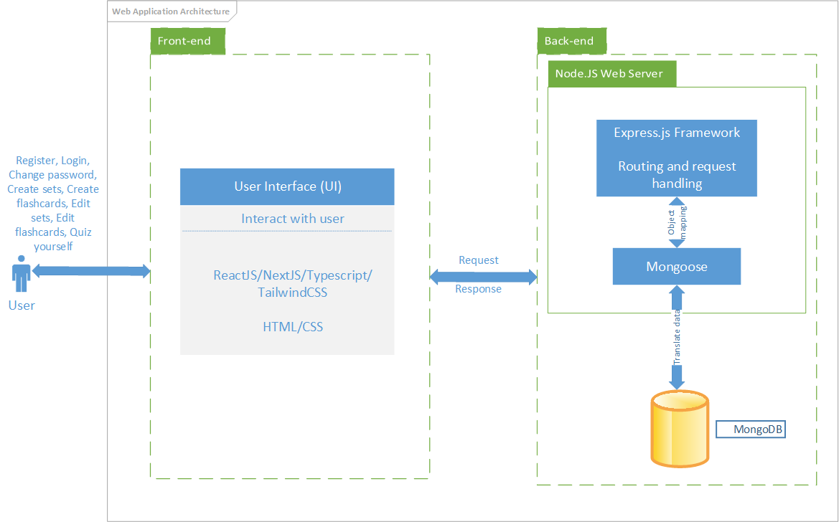
Architecture diagram

Slide 4
Overview of technology
Frontend
HTML/CSS
ReactJS/NextJS/Typescript/Tailwindcss
Backend
NodeJS/ExpressJS
MongoDB

Slide 5
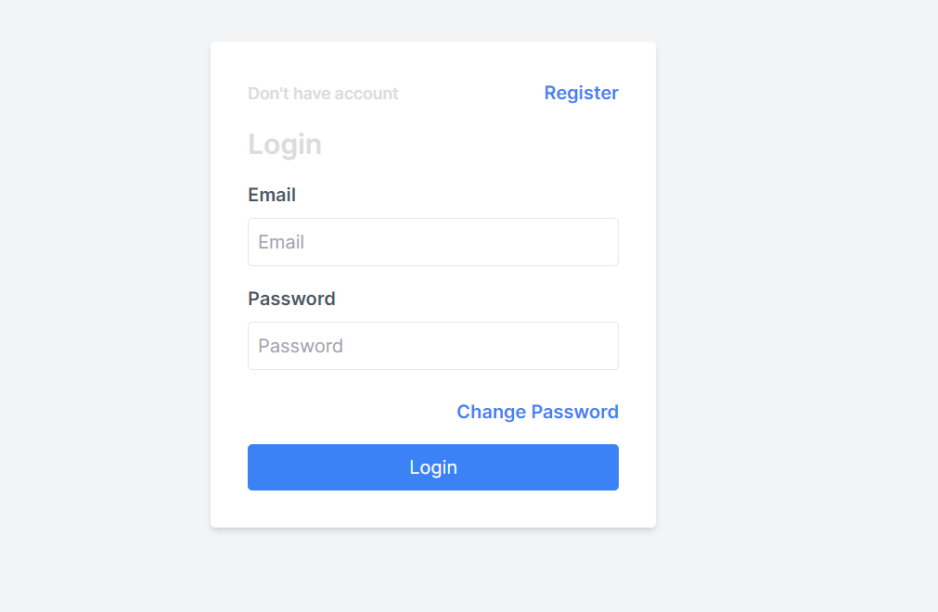
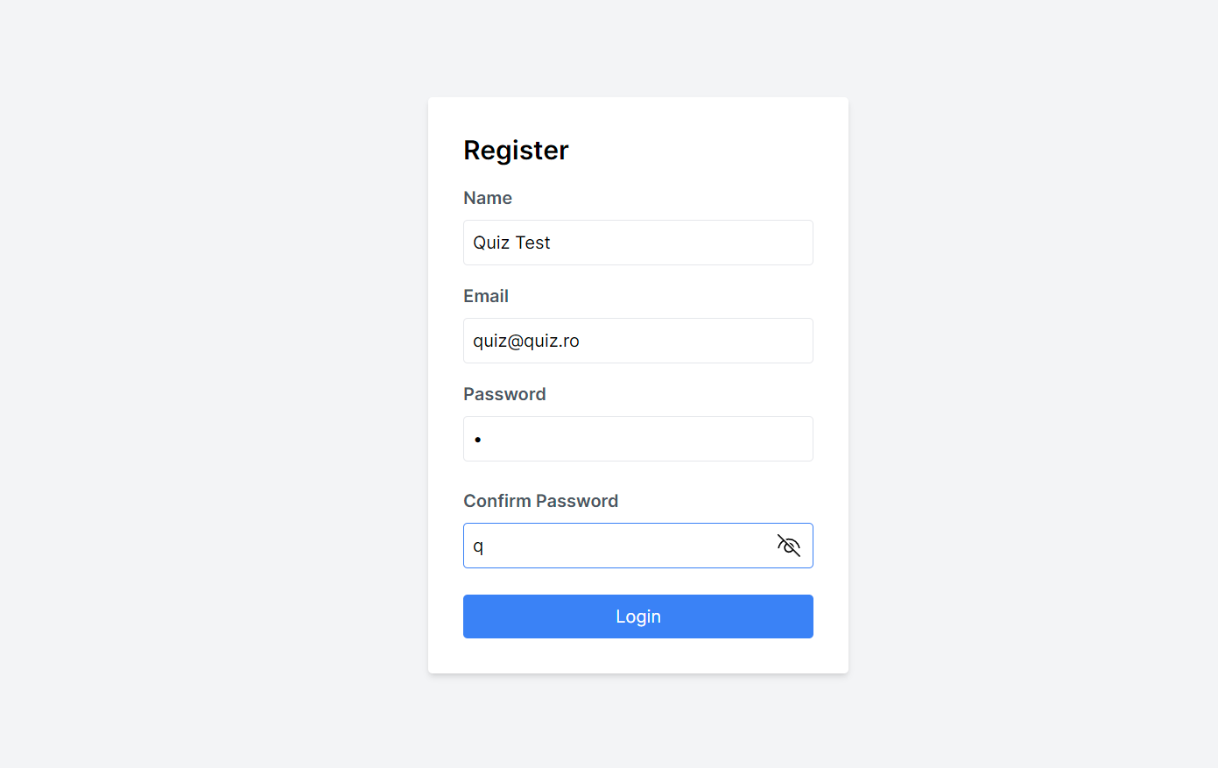
Screenshots of the web application
This is the first page that appears – the login page in the application. If you are not registered yet, access the “Register” button. If you are registered and want to change your password, access the “Change your password” button.
The Registration page. It will verify if all the elements are completed before registering the e-mail/password in the database and return to the “Login” page.

Slide 6
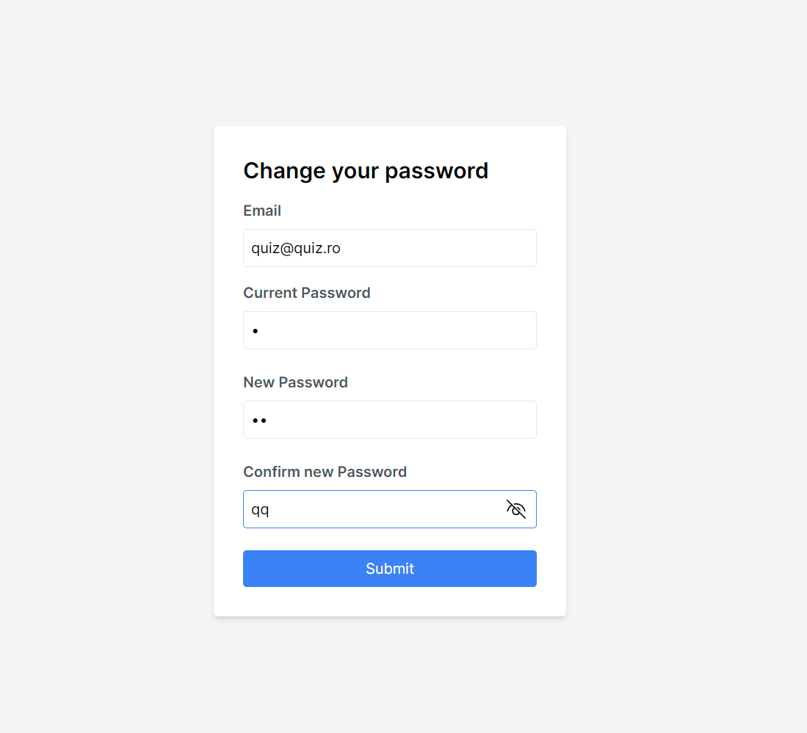
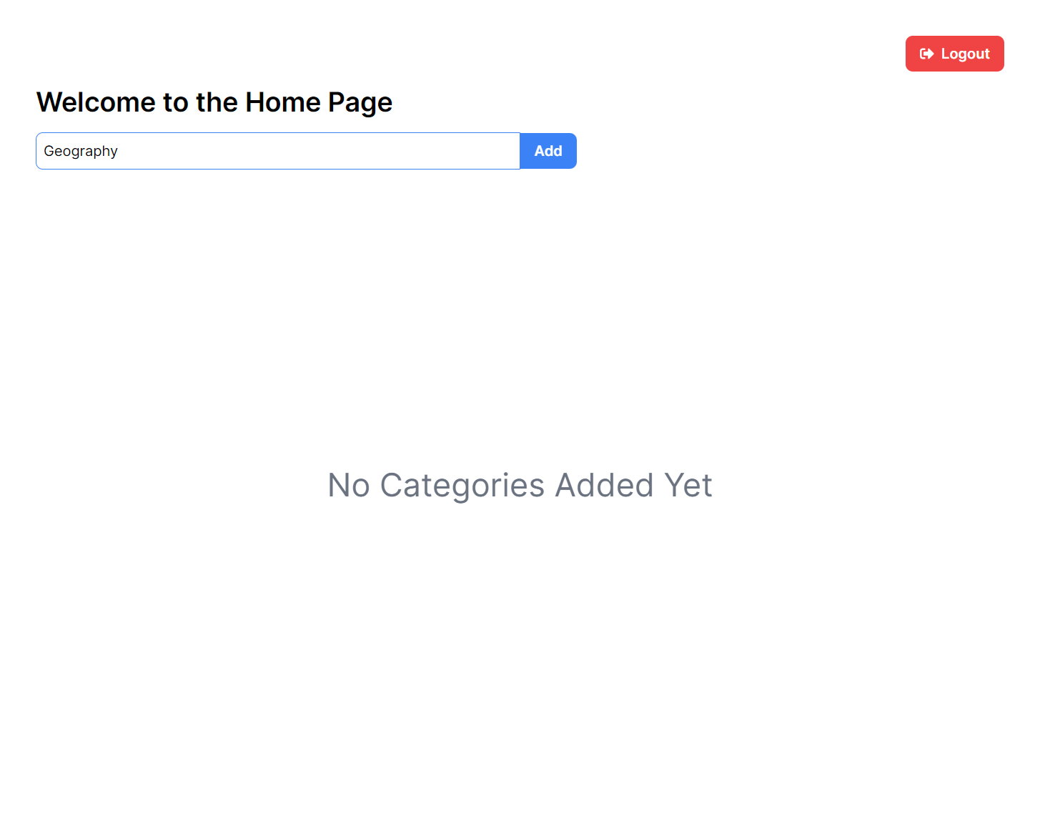
Screenshots of the web application
To change your password, the user must input a valid e-mail/password and input the new password identically in both fields. After submitting the change, it will redirect to the “Login” page.
This is an empty “Home Page”. From here you can Add a new set, if you already have sets of flashcards, change the name of a set, delete, quiz or view the flashcards in a set and “Logout”

Slide 7
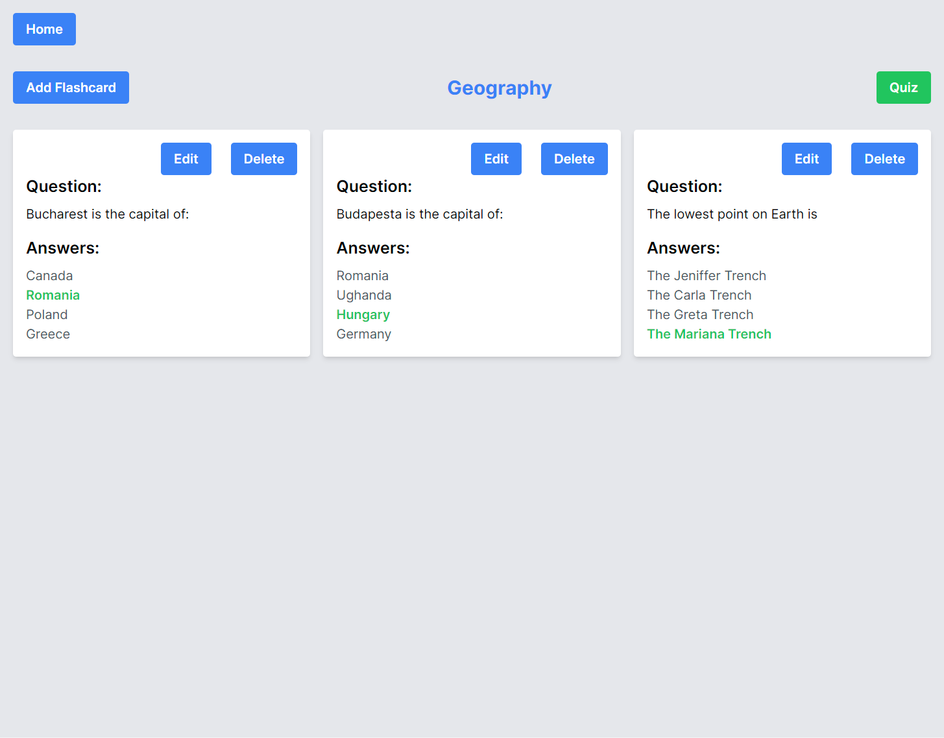
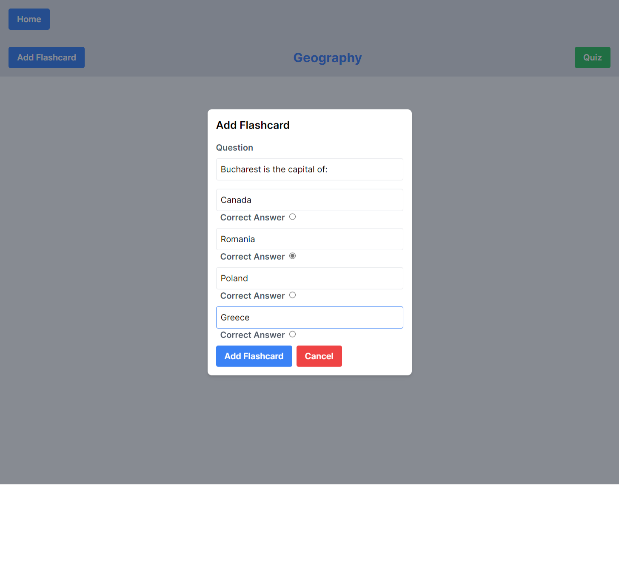
Screenshots of the web application
Inside a set, the name of the set is on top and the flashcard that are in its composition are displayed. From here, the user can Add a Flashcard, Edit or Delete a Flashcard and start a Quiz
Adding a Flashcard is simple – introduce the question and the 4 answers, check the Correct Answer and “Add Flashcard”.

Slide 8
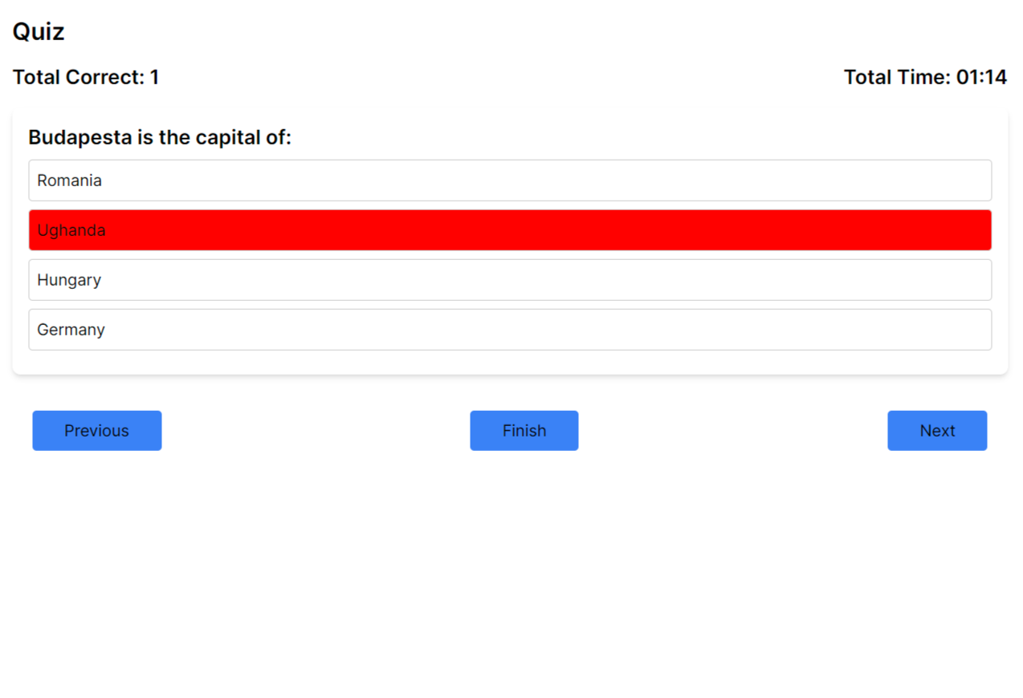
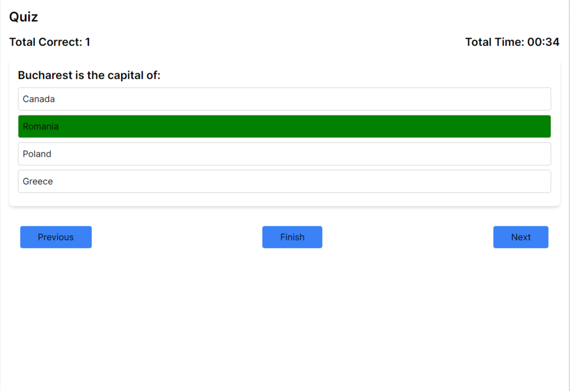
Screenshots of the web application
Quiz time – this is a selected incorrect answer – the user receives visual confirmation by having the background of the answer colored in red.
This is a selected correct answer – the user receives visual confirmation by having the background of the answer colored in green.

Slide 9
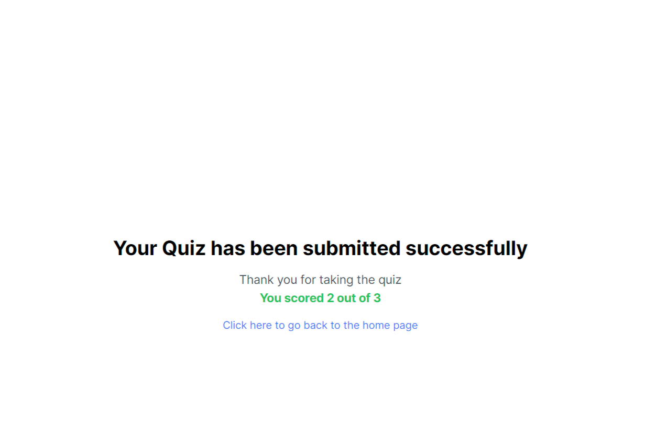
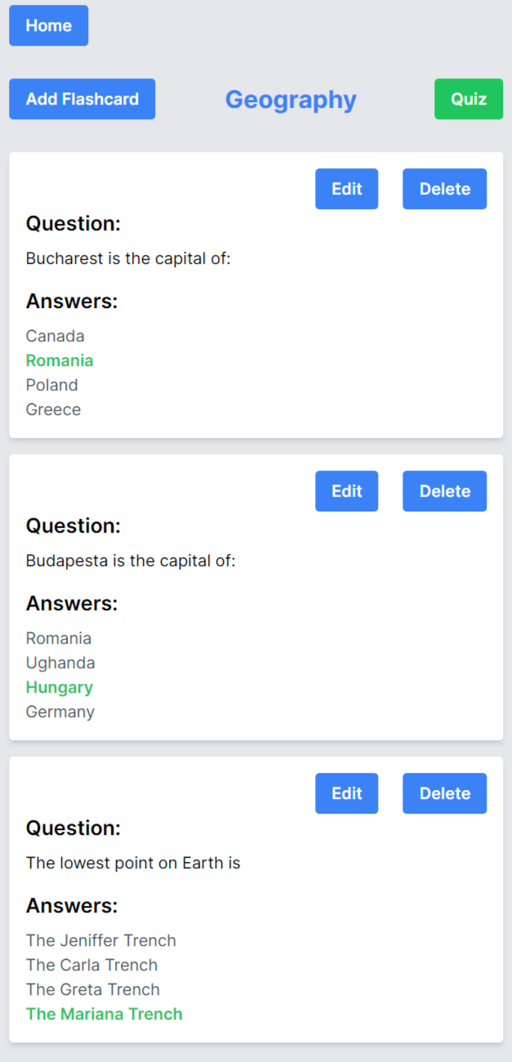
Screenshots of the web application
After the “Finish” button is pressed, the user is presented with the score on how many correct answers/total questions of the quiz
This is how a set is displayed on a narrower browser.

Slide 10
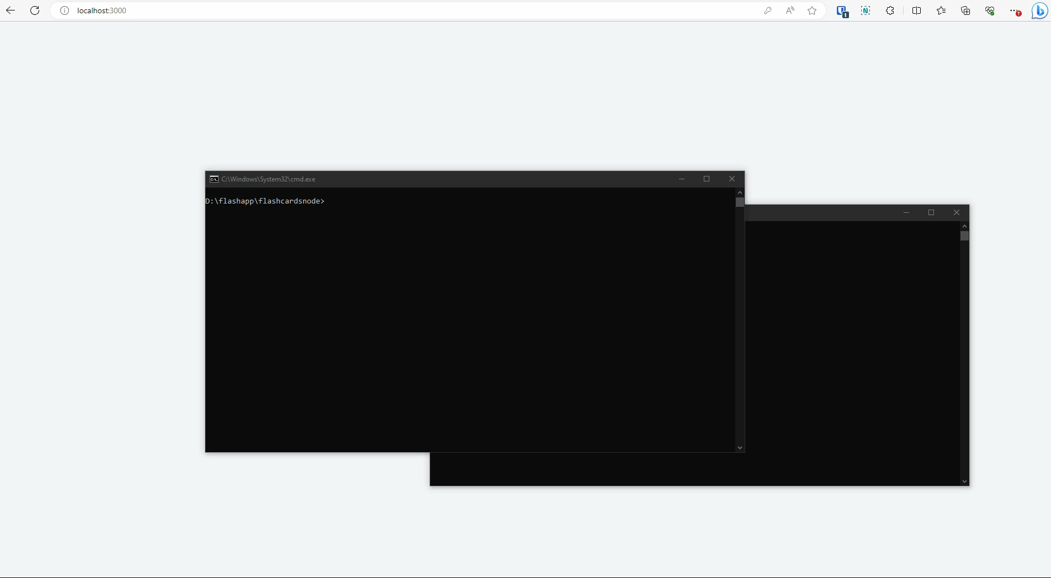
Screencast video

